Slide 1
Low stretch planar geometric spanners of maximum degree 6
Nicolas Bonichon, Cyril Gavoille, Nicolas Hanusse, Ljubomir Perković

Slide 2
Spanner
a
Let G be a weighted graph.
Let H be a subgraph of G.
H is a s-spanner of G if:
s is the stretch of the spanner
4
4
G
b
4
e
5
5
3
3
c
4
d
Example:
H is a 2-spanner of G.
a
4
4
H
b
e
3
3
c
4
d

Slide 3
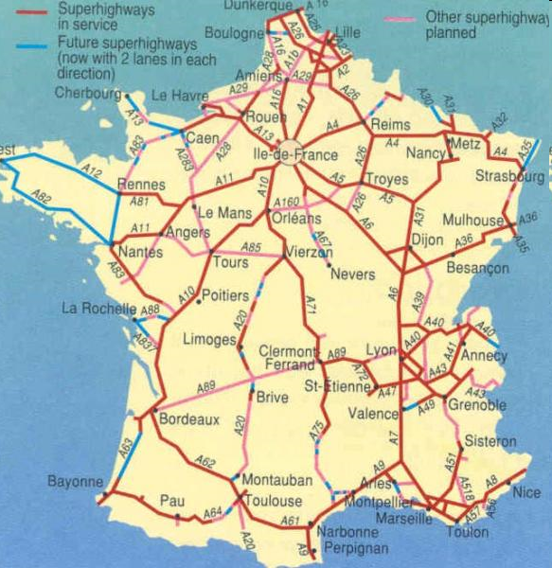
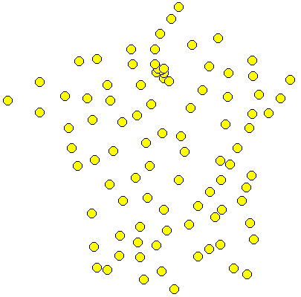
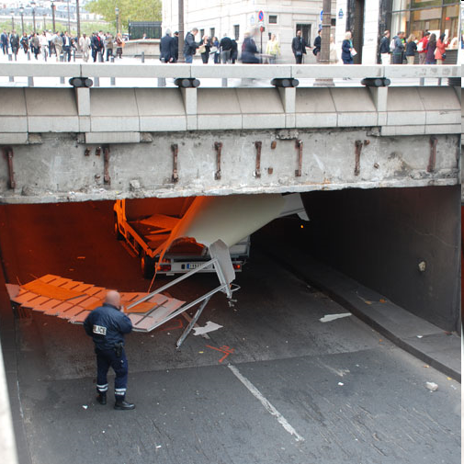
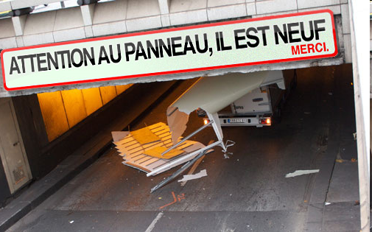
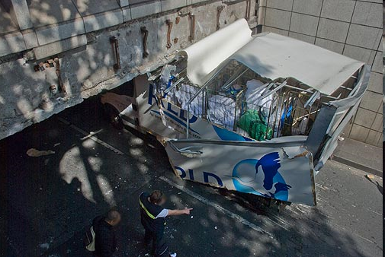
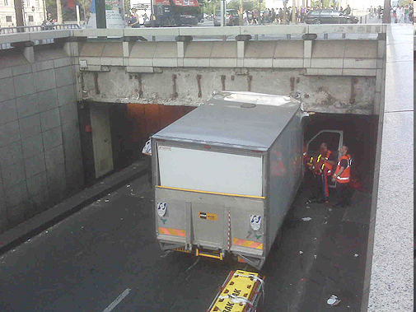
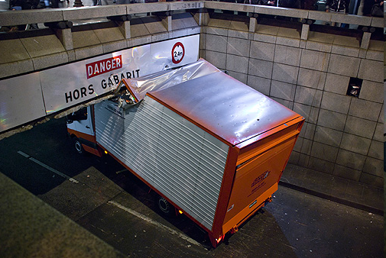
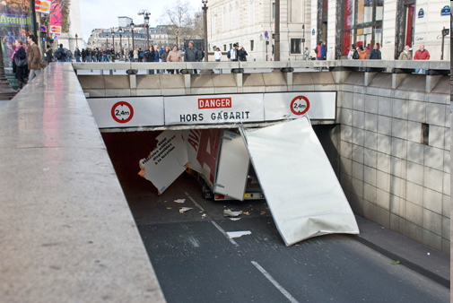
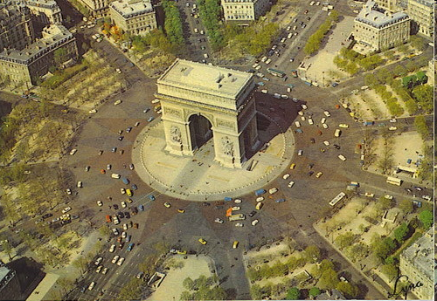
Geometric graphs
Let (E,d) be a metric space.
Let S be a set of points of E.
G(S) is the complete graph.
The length of (u, v) is d(u, v).
In this talk (E,d) is the Euclidean plane
Goals:
Small stretch s
Few edges
Small max degree
Routable
Planar
…
www.2m40.com
Accidents :
- 26 en 2009
10 en 2010
The last one: June 9th

Slide 4
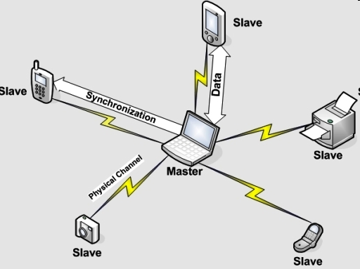
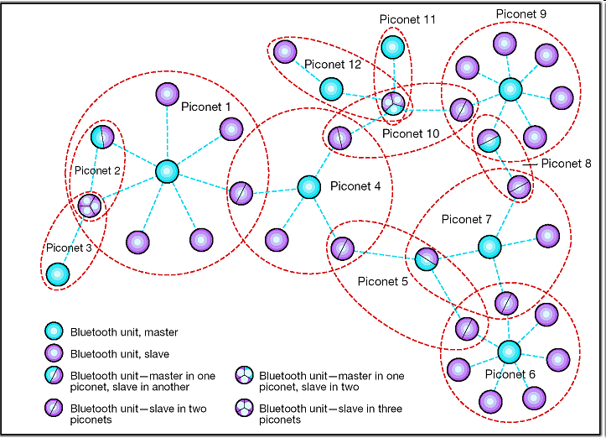
Motivation: scatternet
Source : zdnetasia
Source : http://www.acm.org/crossroads/xrds9-4/blue.html
Piconet: Bluetooth PAN
1 Master
At most 7 slaves
scatternet: ad hoc network composed of piconets.
A node can be a slave for several piconets
A node can be master of only one piconet

Slide 5
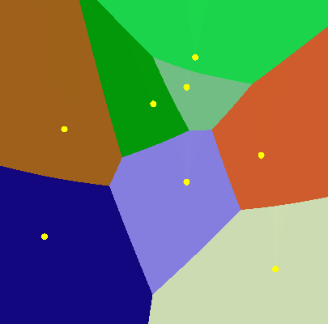
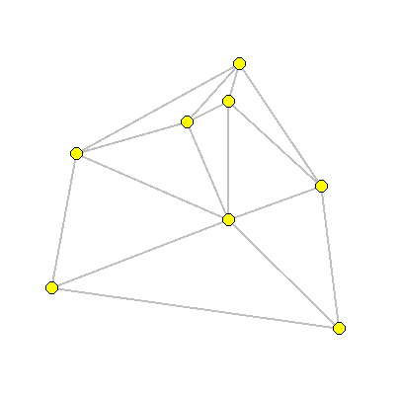
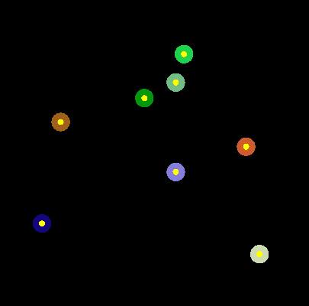
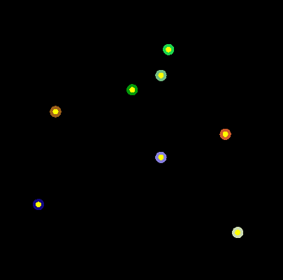
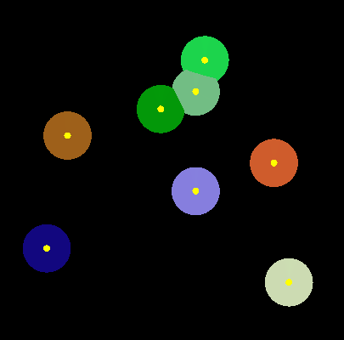
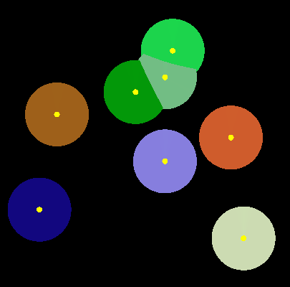
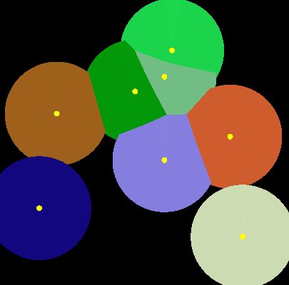
Delaunay Triangulation
Voronoï cell:
Delaunay triangulation:
s_{i} is a neighbor of s_{j} iff
General position:
No 3 points collinear
No 4 points co-circular
[Dobkin et al 90] -spanner
[Keil and Gutwin 92] -spanner

Slide 6
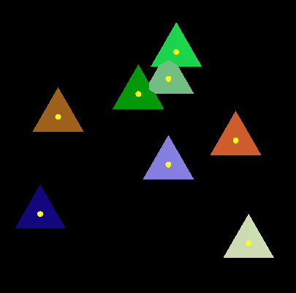
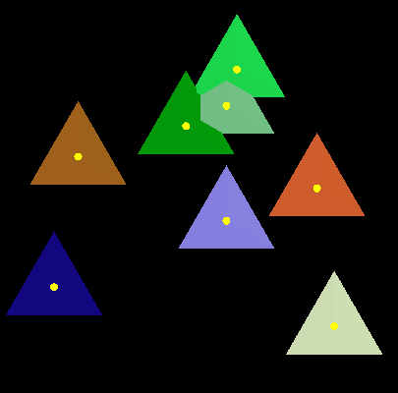
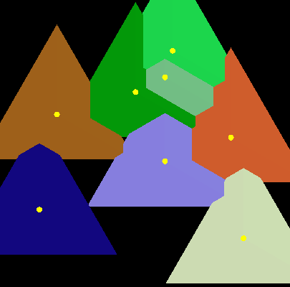
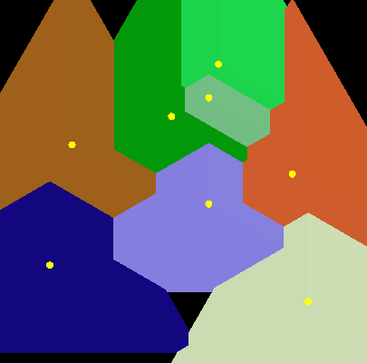
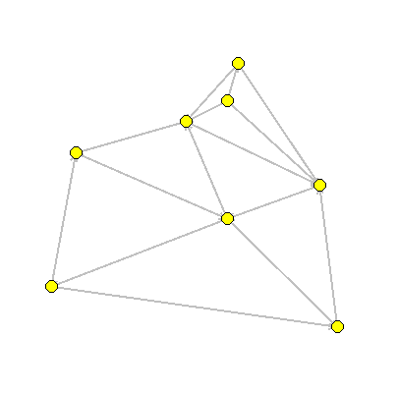
Triangular Distance Delaunay Triangulation [Chew 89]
Triangular “Distance”:
d(u,v) = size of the smallest equilateral triangle centred at u touching v.
Remark: in general d(u,v) ≠ d(v,u)
[Chew 89] TD-Delaunay is a 2-spanner
v
u
d(u,v)

Slide 7
Related work
paper | Δ | stretch factor
[Dobkin et al. 90] | ∞ | 5.08 (Delaunay)
[Keil and Gutwin 92] | ∞ | 2.42 (Delaunay)
[Chew 89] | ∞ | 2 (TD-Delaunay)
[Bose et al. 05] | 27 | 10.016
[Li and Wang 04] | 23 | 7.79
[Bose et al. 09] | 17 | 28.54
[Kanj and Perković 08] | 14 | 3.53
This talk | 12 9 6 | 6

Slide 8
TD-Delaunay as ½-θ₆-graph [Bonichon Gavoille Hanusse Ilcinkas 09]
+
-
-
+
+
-
+
-
-
+
+
-
When 2 triangles touch each other, it is when an tip touches a side.
for each vertex u:
for each positive cone C:
Add an edge toward the vertex v in C with the projection on the bisector that is closest to u.
v
u

Slide 9
H₁₂: 6-spanner with deg_{max}≤12
H₁₂: In each negative cone keep (at most) 3 edges:
The (projective) shortest
The clockwise first
The clockwise last
Degree:

Slide 10
Stretch of H₁₂
u
Idea: H₁₂ (S) is a 3-spanner of TD-Delaunay(S) ⇒ H₁₂ is a 6-spanner.
For each deleted edge wu, we consider the canonical path:
Traverse the face containing u and w using the shortest edge.
v

Slide 11
H₉: 6-spanner with deg_{max}≤9
H₉: keep only the edges of H₁₂ that are in a canonical path.
Charging rule: if a cw-first edge is different from the smallest edge,
it charges the cw-previous cone.
(similarly for cw-last)
Lemma: the charges satisfy
≤ 2
≤ 1
≤ 1
≤ 2
≤ 2
≤ 1

Slide 12
H₆: 6-spanner with deg_{max}≤ 6
H₆: for each positive cone of H₉ with charge 2, apply carefully one of the following rules:
Lemma: the charges become
1
0
1
2
1
1
2
2
1
1
0
1 or 2
2
≤ 1
1
≤ 1
≤ 1
≤ 1
≤ 1
1 or 2
≤ 1

Slide 13
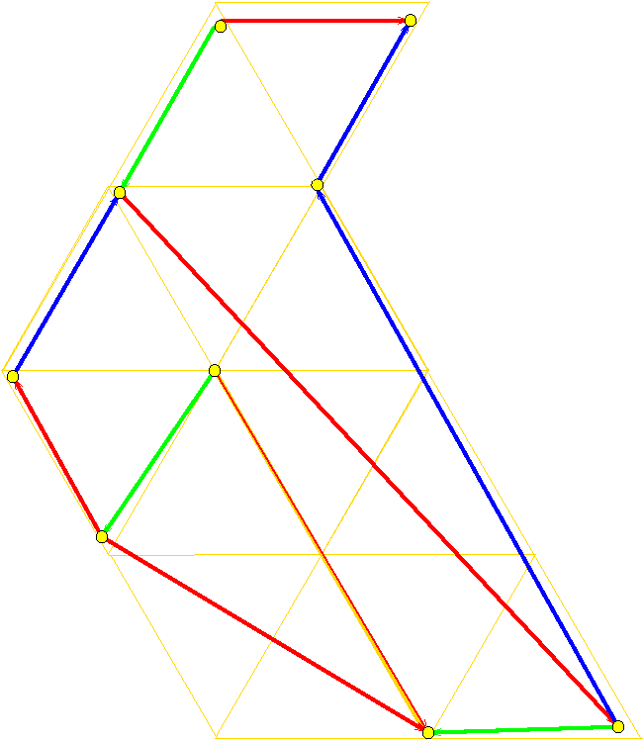
Analysis of the stretch is tight

Slide 14
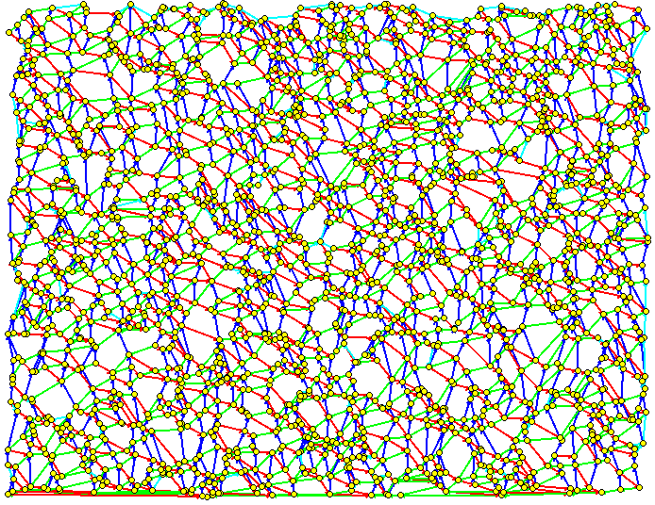
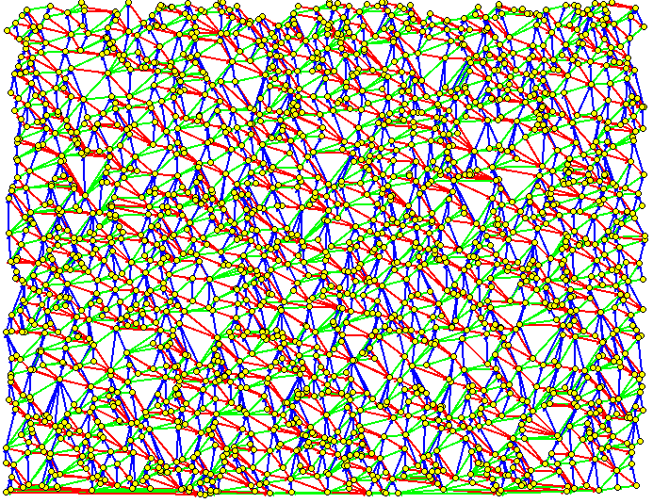
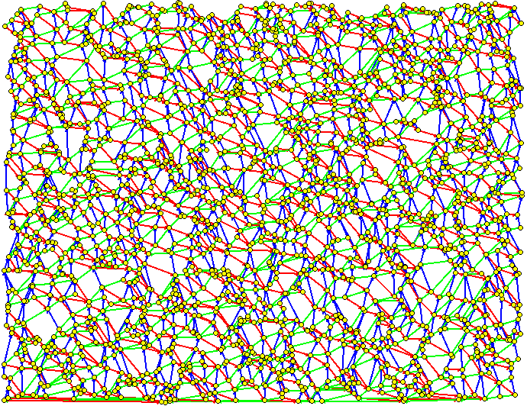
Example with 2000 vertices
TD-D: 5848 edges
H₉: 4588 edges
H₆: 4288 edges

Slide 15
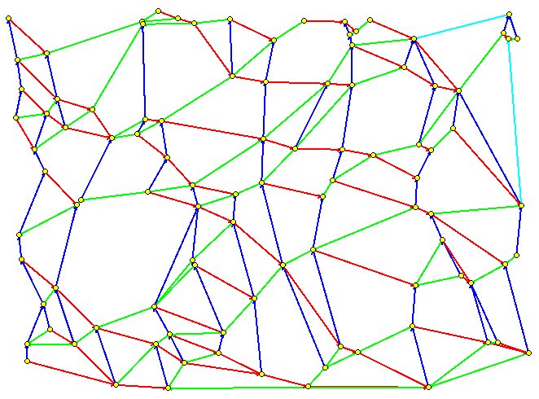
Just for fun…
http://www.labri.fr/~bonichon/Bounded/

