Slide 1
Fully Dynamic Approximate Distance Oracles for Planar Graphs via Forbidden-Set Distance Labels
Presented by:
Shiri Chechik (Weizmann Institute)
Joint with:
Ittai Abraham (Microsoft Research SVC)
Cyril Gavoille (University of Bordeaux)

Slide 2
Distance Oracles
Graph
Data-structure
dist(s,t)
s,t
dist(s,t)
Stretch k:
dist(s,t) ≤ ≤ k∙dist(s,t)

Slide 3
Distance Labeling Schemes
Data structure stored in pieces at the graph vertices (as vertex labels)
Graph
Labels
s
2
2
2
8
…
L_{s}
…
L_{t}
…
4
3
3
3
3
2
t
Distance Query
8

Slide 4
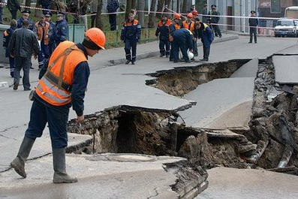
Fault Tolerance
Assumption: Networks are dynamic. Some resources may occasionally fail or malfunction

Slide 5
FT Distance Oracles
Data structure capable of answering:
“what is the distance between s and t in G\F”
Graph
Data-structure
dist(s,t,G\F)
s,t,F

Slide 6
FT Distance Labeling Schemes
Graph
Labels
s
2
2
2
8
…
L_{s}
…
L_{z}
…
L_{t}
…
4
3
3
z
3
3
2
t
Distance Query
≈ 11

Slide 7
FT Distance Oracles
Related Work
[Demetrescu,Thorup 02] Single edge failure
[Bernstein, Karger 09] Single edge\vertex failure
[Duan, Pettie 09] Dual-failures
[Courcelle, Twigg 07, Twigg 06] Bounded tree-width
[Chechik, Langberg, Peleg, Roditty 10] Multiple edge failures
[Khanna, Baswana 10] Single vertex failure
[Abraham, Chechik, Gavoille, Peleg 10] Unweighted graphs of bounded doubling dimension

Slide 8
FT Distance Oracles
Related Work
[Baswana, Lath, Mehta 12]
Planar Graph
Exact distances
Single failure

Slide 9
Results
FT Labeling Scheme
Weighted planar graphs
Vertex\edge failures
1+ε stretch
Label size ≈ O(log⁴n/ε)
Query time: Õ(|F|²)

Slide 10
Dynamic Distance Oracles
Graph
delete v
add v
delete e
Data-structure
dist(s,t)
add e
s,t

Slide 11
Dynamic Distance Oracles
Results
Pervious: [Klein, Subramanian 98]
Worst case query time - Õ(n^{2/3})
Amortized update time - Õ(n^{2/3})
New:
Worst case query time - Õ(n^{1/2})
Worst case update time - Õ(n^{1/2})
  General scheme for transforming
  ft-labeling scheme into a fully dynamic distance oracle.
  Gives non-trivial fully dynamic distance oracles:
    Bounded tree-width
    Bounded doubling dimension
    Planar graphs

Slide 12
Results
FT Routing Scheme
1+ε stretch
Table\Label size: O(log⁵n/ε²)

Slide 13
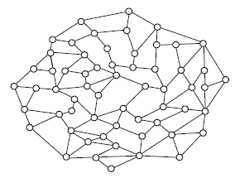

Planar Graphs
Graphs that can be drawn in the plane without crossing edges.

Slide 14
Planar Graphs
Thm:
For any SSSP tree T, there is a non-tree edge e such that the unique simple cycle C in T∪e separates G into two parts of at most 2/3∙n vertices.
[Lipton and Tarjan 79]

Slide 15
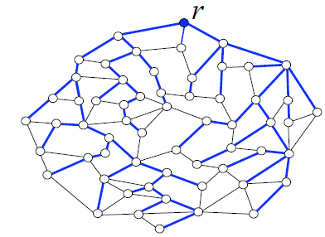
Planar Graphs
Thm:
For any SSSP tree T, there is a non-tree edge e such that the unique simple cycle C in T∪e separates G into two parts of at most 2/3∙n vertices.
[Lipton and Tarjan 79]

Slide 16
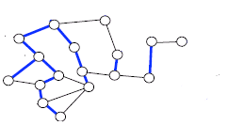
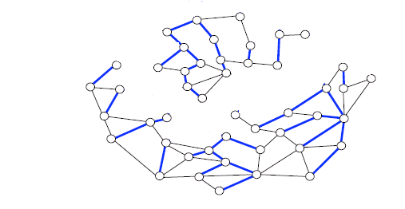
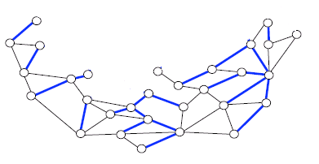
Tree of Separators
…

Slide 17
Tree of Separators
…

Slide 18
Tree of Separators
Properties:
The depth of the tree is O(logn)
Each vertex belongs to
O(logn) clusters
x
…

Slide 19
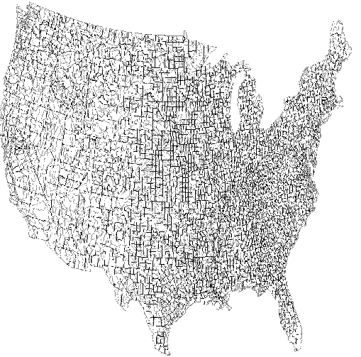
Labeling Scheme – Failure Free
The label FFL(v):
For every cluster C such that v∈C, store N(v,P1), N(v,P2)
(P₁ ,P₂ - the paths separator
of C)
v

Slide 20
Labeling Scheme – Failure Free
N(v,P):
Set of O(logn/ε) net points.
For each such net point
y store (v,y)
Important Property:
For every node x∈P, v has
a net-point at distance
O(ε∙dist(v,x))
d
v
x

Slide 21
Labeling Scheme – Failure Free
The query phase:
Construct a graph H
Invoke a shortest path
algorithm from s to t
s
Construction of H:
Add all edges in
FFL(s) + FFL(t)
For every two net-points that
belong to the same separator
add an edge between them
t

Slide 22
Labeling Scheme – Failure Free
Analysis:
s
d₁
r
d₂
t

Slide 23
Labeling Scheme – Failure Free
Analysis:
s
d₁
r
x₂
x₁
d₂
t

Slide 24
Labeling Scheme – Failure Free
Analysis:
dist(s,t,H) ≤
dist(s,x₁) + dist(x₁,x₂) + dist(x₂,t)
≈
(d₁ + εd₁) + εd₁ + εd₂ +
(d₂ + εd₂)
≈
dist(s,t) + O(ε dist(s,t))
s
d₁
r
x₂
x₁
d₂
t

Slide 25
FT Labeling Scheme
The label L(v) :
Collection of FFL(x)
for some vertices x
2d
d
d
v
c_{v}
d
2d

Slide 26
FT Labeling Scheme
The query phase:
Construct a graph H
Invoke a shortest path
algorithm from s to t
Construction of H:
Add all “safe” edges in
{L(s),L(t)} ∪ {L(f)|f∈F}
s
2d
d₁
x₁
x₂
d
c_{v}
d₂
t
d
2d

Slide 27
FT Labeling Scheme
s
x₁
r
x₂
t

Slide 28
FT Labeling Scheme
s
×
f₁
x₁
r
×
x₂
f₂
t

Slide 29
FT Labeling Scheme
s
f₁
r
f₂
t

Slide 30
FT Labeling Scheme
s
f₁
z₁
r
z₂
t
f₂

Slide 31
Summary
FT Labeling Scheme
1+ε stretch
Label size ≈ O(log⁴n/ε)
Query time: Õ(|F|²)
Fully Dynamic Distance Oracle
1+ε stretch
Worst case query time - Õ(n^{1/2})
Worst case update time - Õ(n^{1/2})
FT Routing Scheme
1+ε stretch
Table\Label size: O(log⁵n/ε²)

Slide 32
Open Problems
Improve bounds
Exact distance oracles with multiple failures
General graphs – vertex failures
Thank You!

